Slide 1
HTML

Slide 2
HTML
HTML (HyperText Markup Language) is the standard language used to create and structure content on the web. It provides the basic framework for web pages by defining the elements and layout of a website.
HTML is not a programming language; instead, it's a markup language.

Slide 3
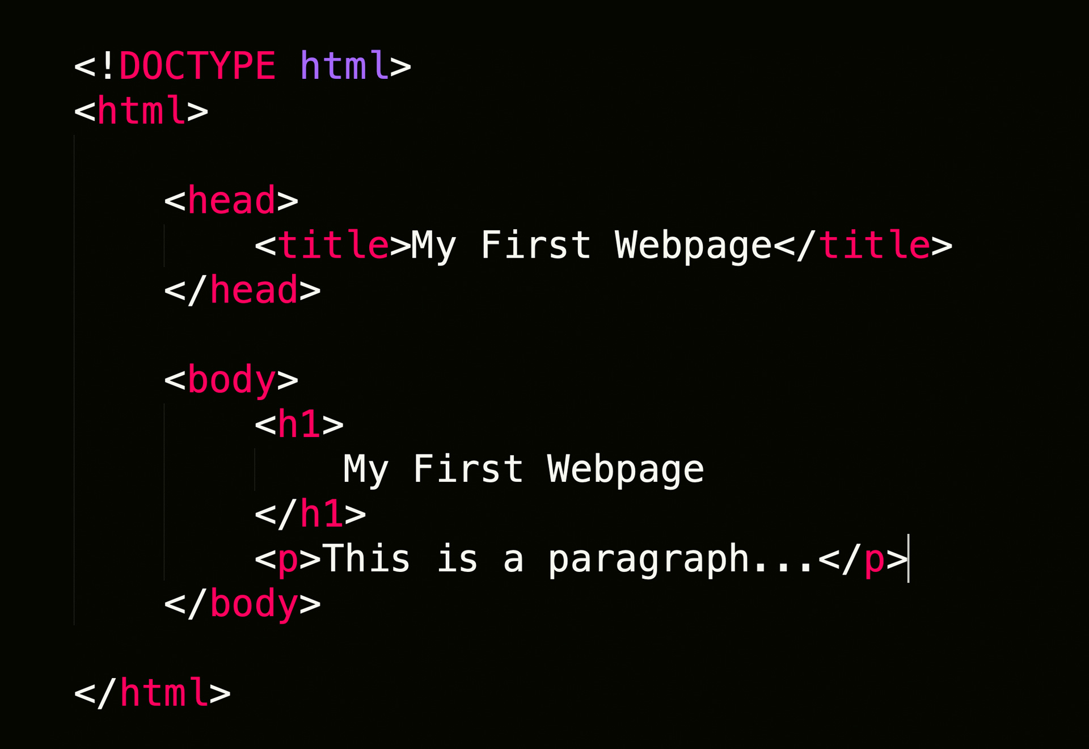
EXAMPLE

Slide 4
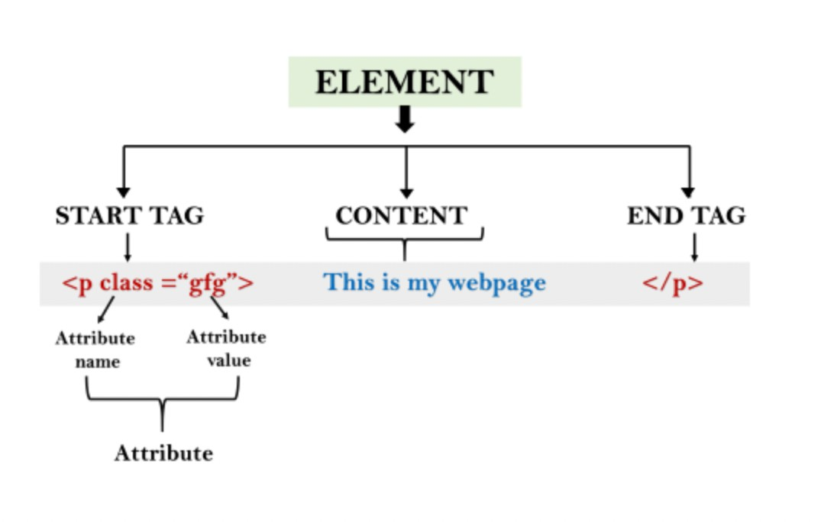
Building Blocks
Tags
Attributes
Elements

Slide 5
Tags
Structural Tags
Heading Tags
Text Formatting Tags
List Tags
Link and Navigation Tags
Image and Media Tags
Table Tags
Form Tags
Semantic Tags
Metadata Tags

Slide 6
Structural Tags
These tags define the basic structure of an HTML document.
<html>: The root element that wraps all other content in the document.
<head>: Contains meta-information about the document, like its title and links to stylesheets.
<body>: Contains the content that is visible to the user.
<title>: Sets the title of the document, displayed in the browser's title bar or tab.

Slide 7
Heading Tags
Used to define headings of various levels.
<h1> to <h6>: Defines headings, where <h1> is the highest (or most important) level, and <h6> is the lowest.

Slide 8
Text Formatting Tags
These tags are used to format text.
<p>: Defines a paragraph.
<b>: Makes text bold.
<i>: Italicizes text.
<u>: Underlines text.
<strong>: Denotes important text, usually bold.
<em>: Emphasizes text, usually italic.
<br>: Inserts a line break.
<hr>: Inserts a horizontal rule (line).
<mark>: Highlights text.

Slide 9
List Tags
Used to create lists.
<ul>: Defines an unordered (bulleted) list.
<ol>: Defines an ordered (numbered) list.
<li>: Defines a list item, used inside <ul> or <ol>.

Slide 10
Link and Navigation Tags
Used to create hyperlinks and navigation elements.
<a>: Creates a hyperlink.
<nav>: Defines a navigation section.

Slide 11
Image and Media Tags
Used to embed images, audio, and video.
<img>: Embeds an image.
<audio>: Embeds audio content.
<video>: Embeds video content.
<source>: Specifies multiple media resources for <audio> or <video>.

Slide 12
Table Tags
Used to create tables.
<table>: Defines a table.
<tr>: Defines a table row.
<td>: Defines a table cell.
<th>: Defines a header cell in a table.
<caption>: Provides a caption for the table.
<thead>, <tbody>, <tfoot>: Group table rows into a header, body, and footer.

Slide 13
Form Tags
Used to create forms for user input.
<form>: Defines a form.
<input>: Defines an input field.
<label>: Associates a label with an input element.
<textarea>: Defines a multi-line text input.
<button>: Defines a clickable button.
<select>: Creates a dropdown list.
<option>: Defines an option in a dropdown list.

Slide 14
Semantic Tags
Introduced in HTML5, these tags give meaning to the structure of a webpage.
<header>: Represents a container for introductory content or navigational links.
<footer>: Represents the footer of a document or section.
<article>: Represents independent content that could stand alone.
<section>: Defines a section in a document.
<aside>: Represents a section of the page that is related to the content around it, often used for sidebars.
<main>: Represents the dominant content of the <body>.
<figure>: Represents self-contained content, often with a caption, like an image.
<figcaption>: Provides a caption for a <figure>.

Slide 15
Metadata Tags
Provide metadata about the HTML document.
<meta>: Provides metadata such as the character set, author, or description.
<link>: Links external resources like stylesheets.
<style>: Embeds CSS styles within an HTML document.
<script>: Embeds or references JavaScript code.

Slide 16
HTML Elements
Inline Elements/Tags: These do not start on a new line and only take up as much width as necessary (e.g., <span>, <a>, <strong>).
Block-level Elements/Tags: These start on a new line and take up the full width available (e.g., <div>, <p>, <h1>).

Slide 17
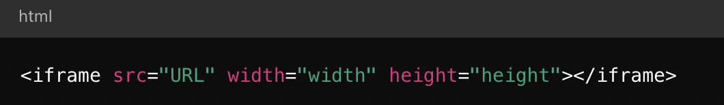
Iframe
The <iframe> element in HTML is used to embed another HTML document within the current document.
An acronym for inline frame, <iframe> allows you to display content from another source, such as another webpage, within a frame on your webpage.
This is particularly useful for embedding things like videos, maps, or other web content.

